Slide 1
Teach reading: change lives
Parent workshop: Phonics and early reading

Slide 2
A love of reading is the biggest indicator of future academic success.
OECD (The Organisation for Economic Co-operation and Development)

Slide 3


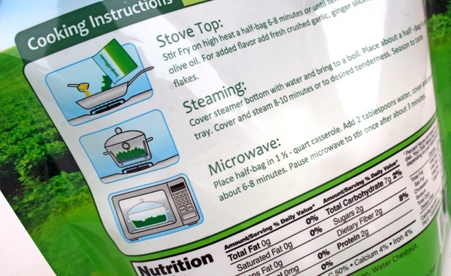
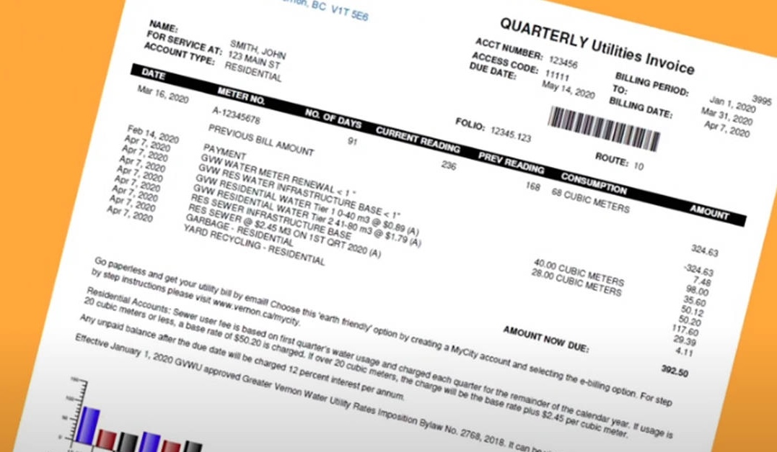
How many times have you already read today?
Notes:
Just think about how many times you have already read things today. It really is a vital skill.

Slide 4

Phonics

Slide 5
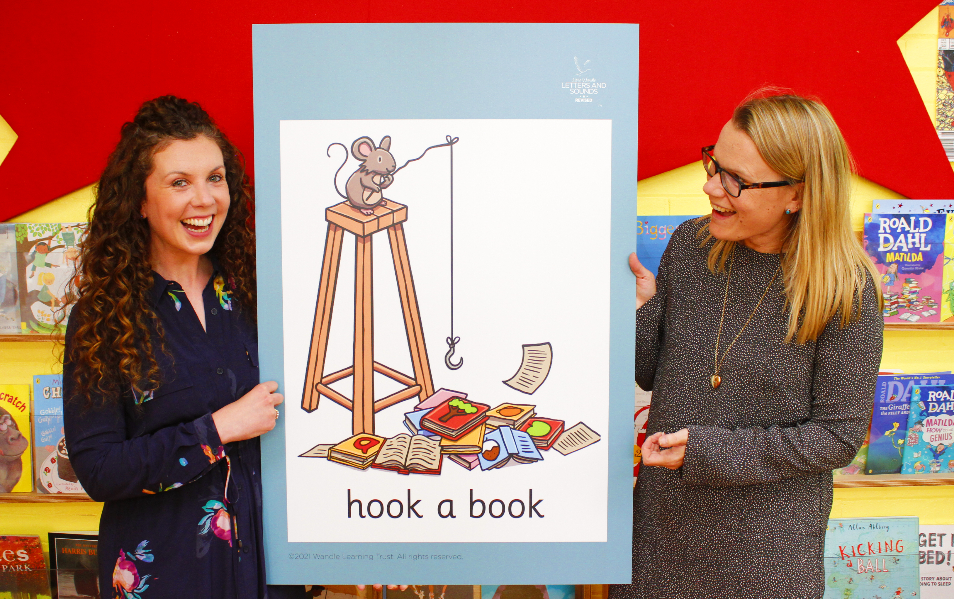
Little Wandle Letters and Sounds Revised
Our school has chosen
Little Wandle Letters and Sounds Revised as our systematic, synthetic phonics (SSP) programme to teach early reading and spelling.

Slide 6
Phonics is:
making connections between the sounds of our spoken words and the letters that are used to write them down.
Notes:
It sounds complicated but it really isn’t!

Slide 7
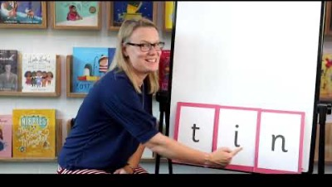
Blending to read words
Notes:
Some children learn to blend really quickly, and others take a little longer. If your child is finding it difficult, ask us for ways to help at home – playing blending games at home is so helpful!
Show parents this video from the website: https://www.littlewandlelettersandsounds.org.uk/resources/for-parents/

Slide 8
Terminology
The smallest unit of sound that can be identified in words. We sometimes simply call this a ‘sound’
Phoneme
A letter or group of letters used to represent a particular phoneme when writing.
Grapheme
A grapheme using two letters to represent one phoneme. With children, we frequently reinforce it with the mantra ‘two letters, one sound’. E.g. shop, goat
Digraph
Trigraph
A grapheme using three letters to represent one phoneme. With children, we frequently reinforce it with the mantra ‘three letters, one sound’ e.g. light, beard
Notes:
Explain what each word means – include glossary in parent phonics pack: https://www.littlewandlelettersandsounds.org.uk/resources/my-letters-and-sounds/getting-started/

Slide 9
A grapheme using two letters to represent one phoneme. E.g slide
Split vowel digraph
To combine individual phonemes into a whole word, working all the way through from left to right.
Blend
To identify each of the individual phonemes in a word, working all the way through from left to right.
Segment

Slide 10
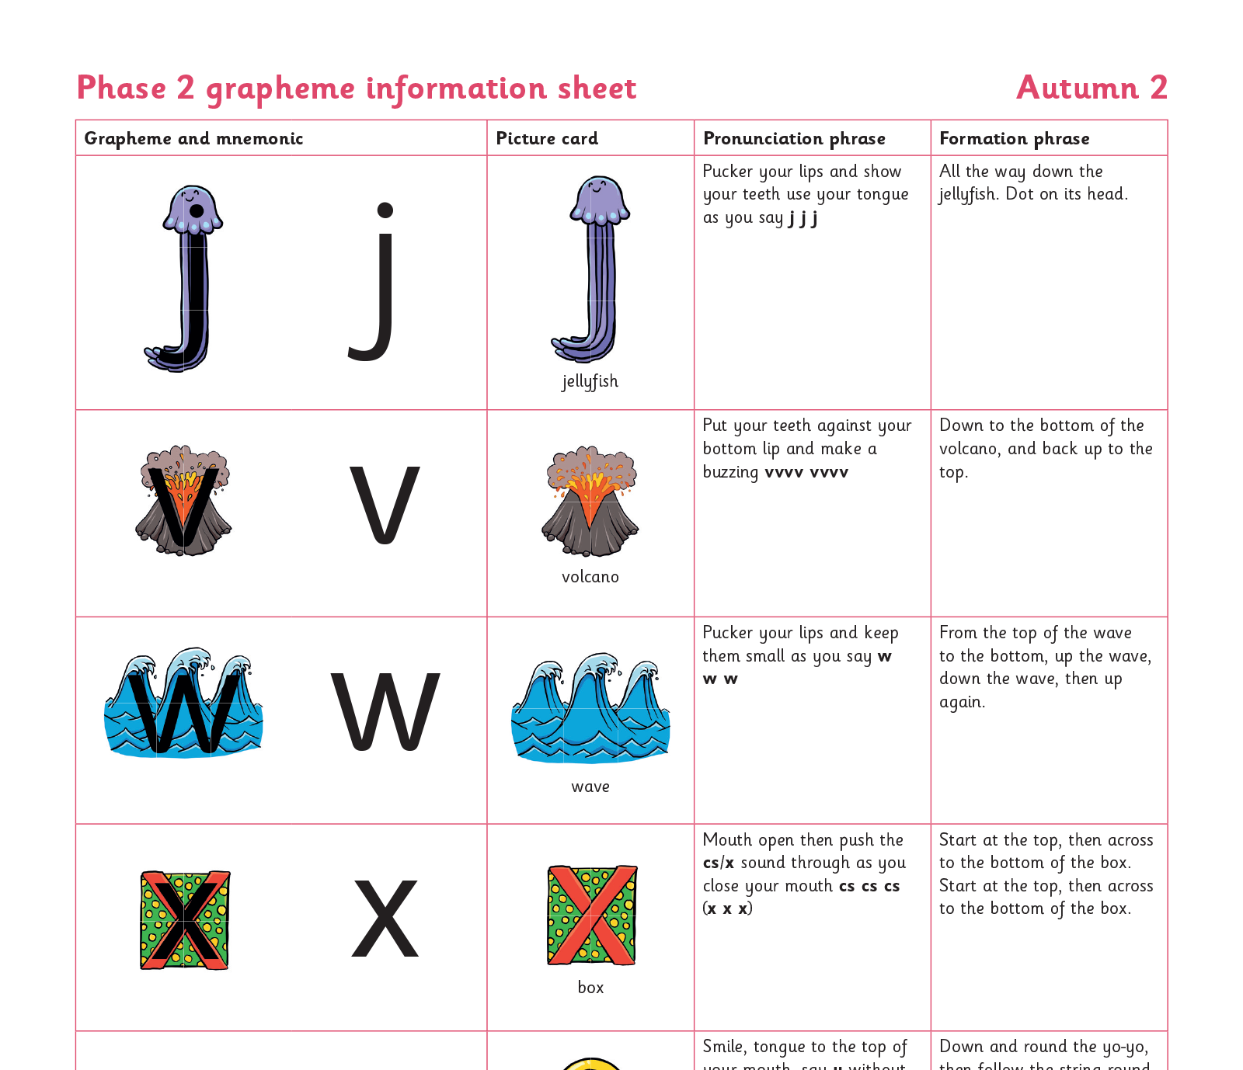
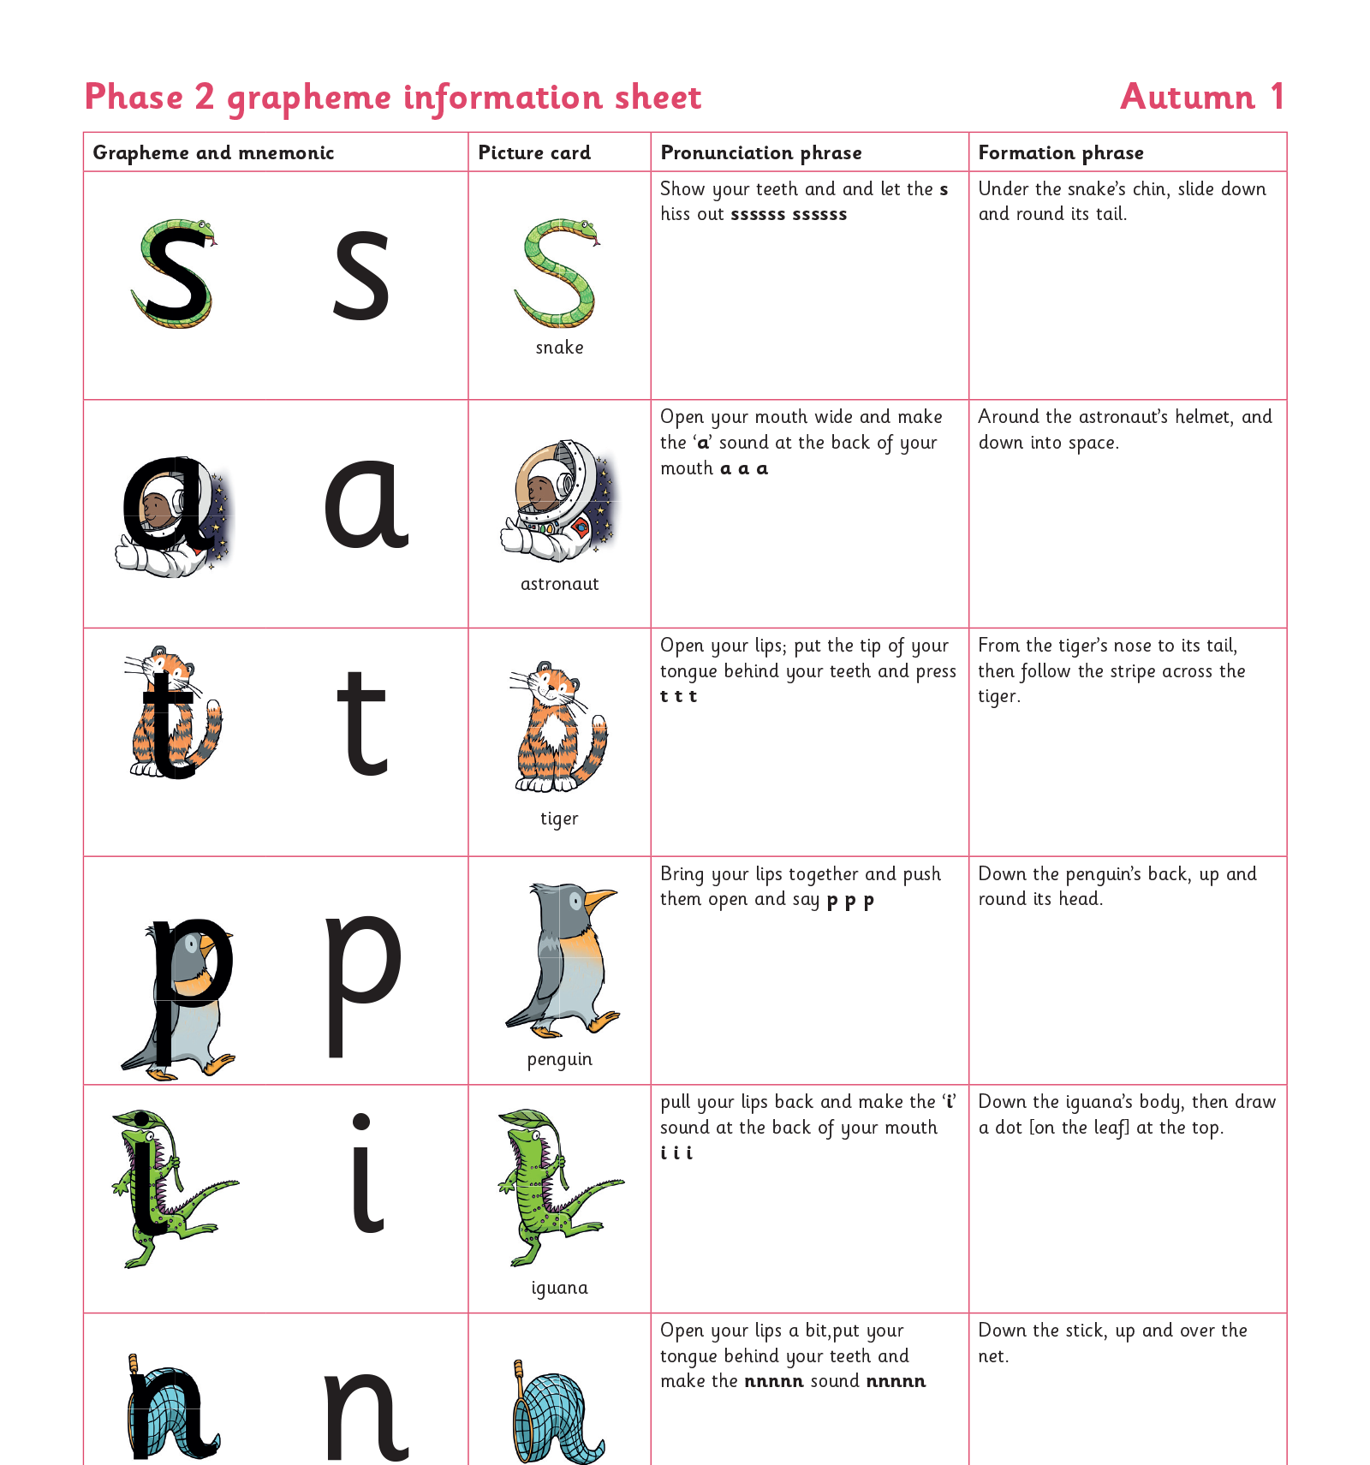
Teaching order
Notes:
We usually teach four new sounds a week and have a review lesson on a Friday. You will get a list of the sounds that we are learning to have at home. This will help you with formation and pronunciation. (Discuss home learning later)

Slide 11
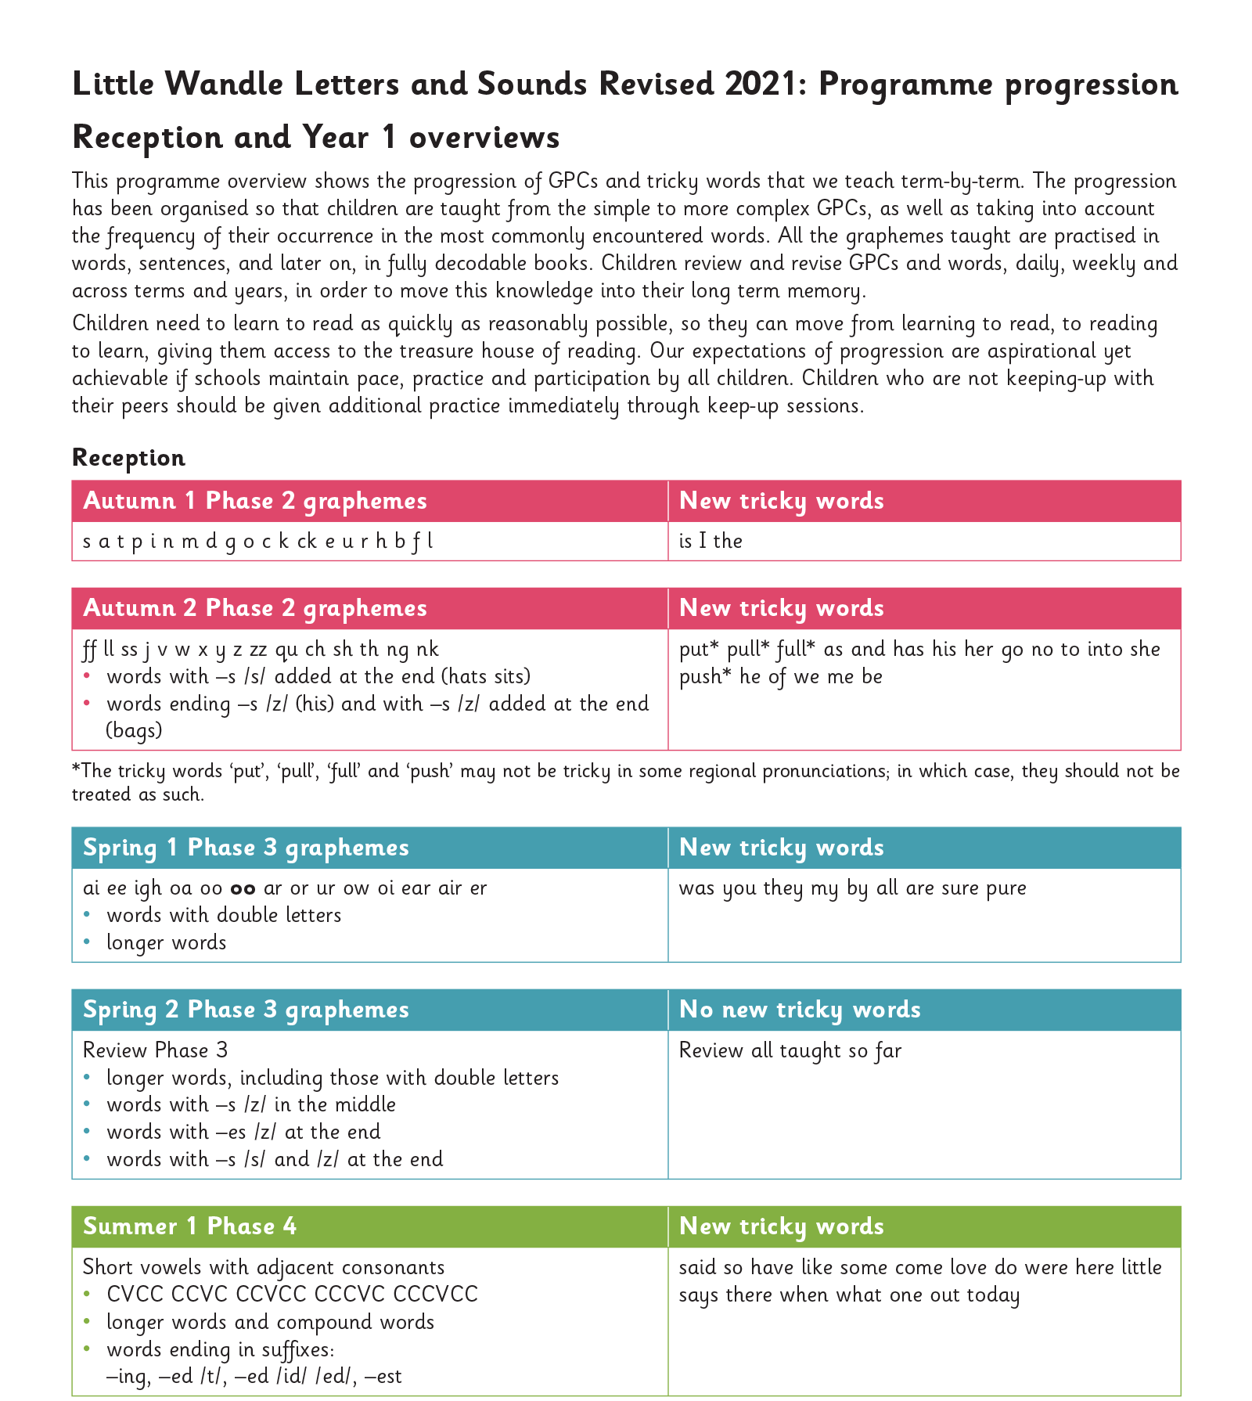
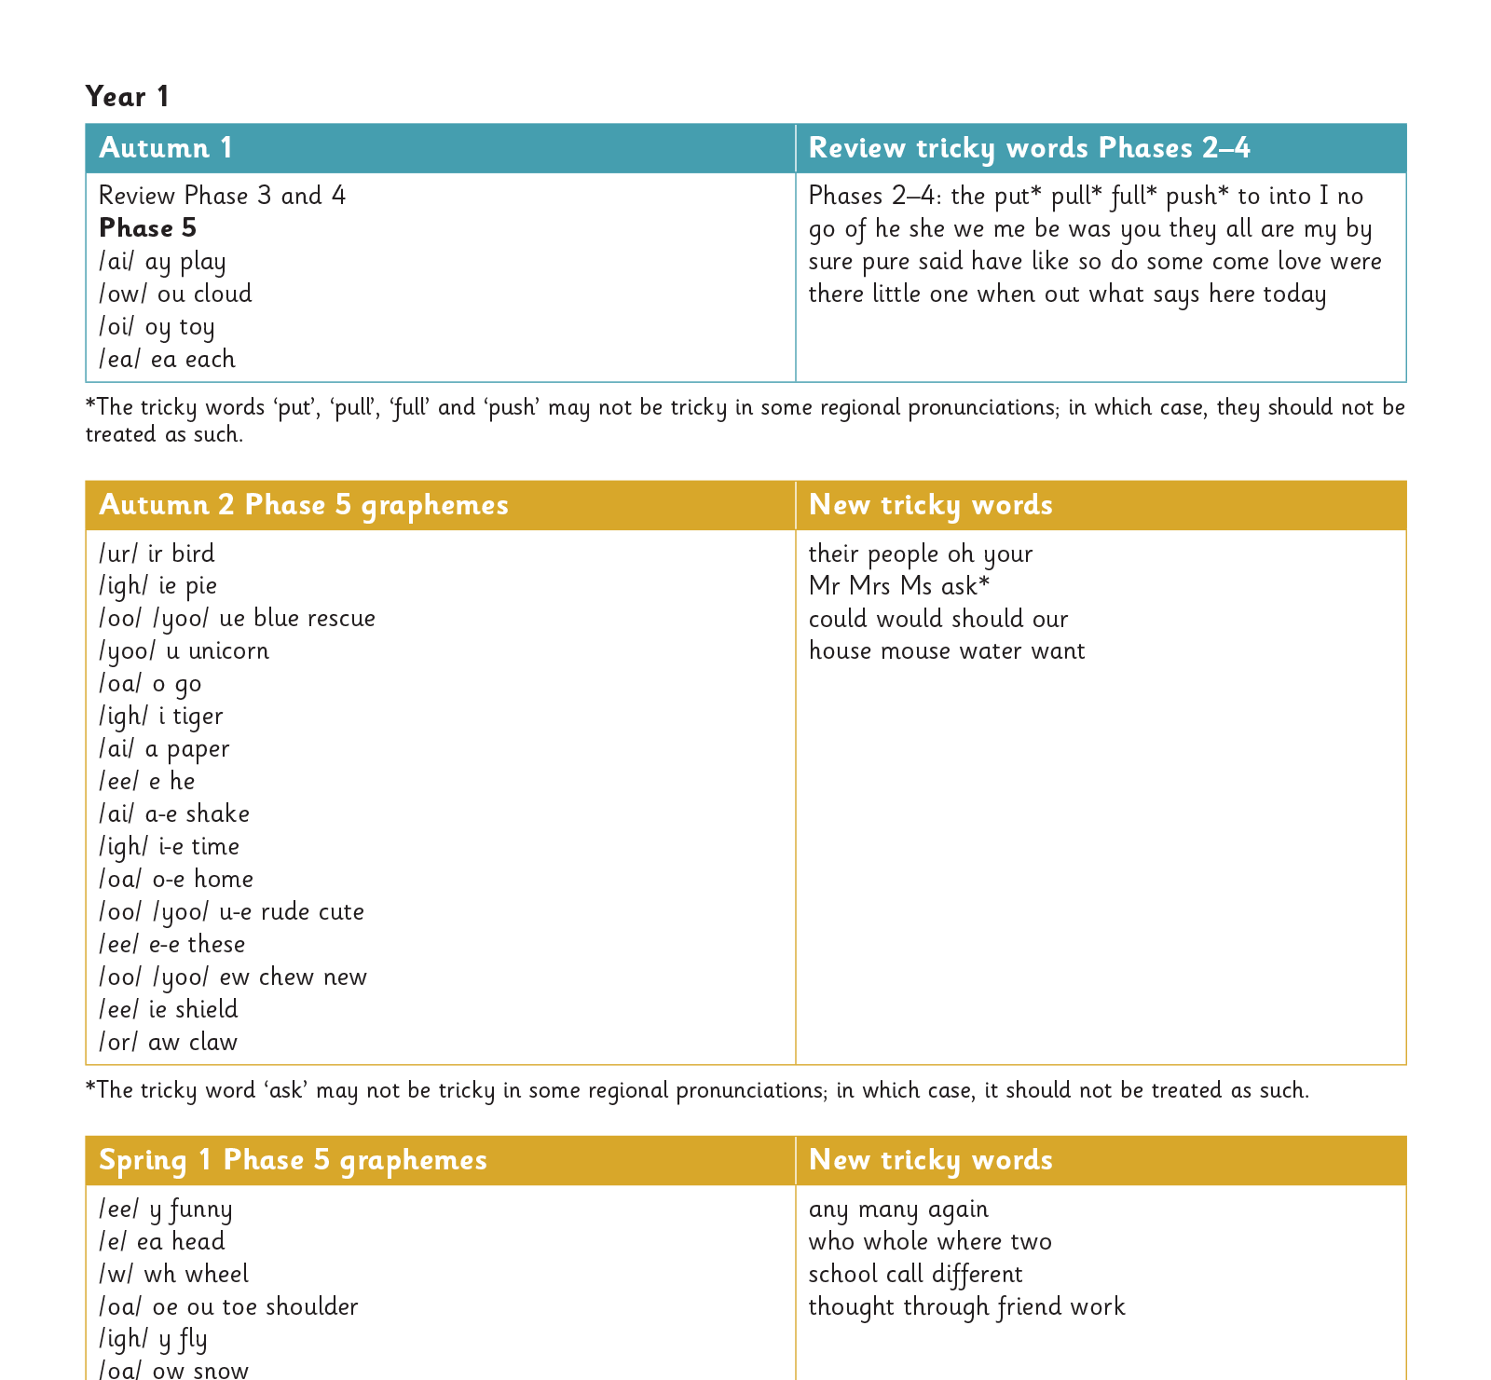
Gradually your child learns the entire alphabetic code:
Notes:
We will work our way through the whole Little Wandle Programme until your child can read fluently. Add to website to show progression??

Slide 12
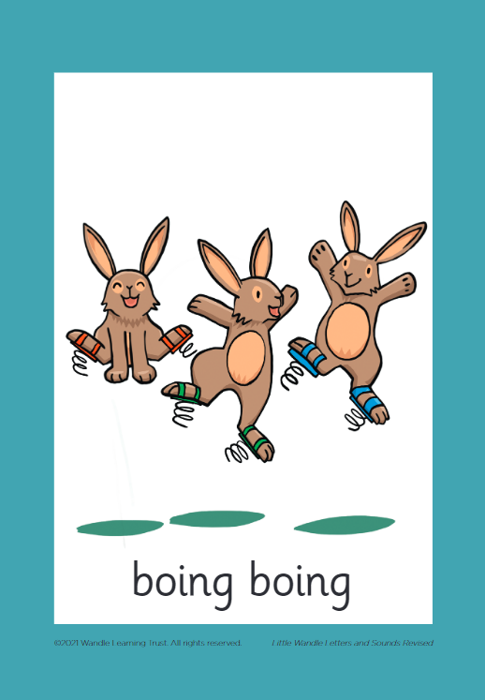

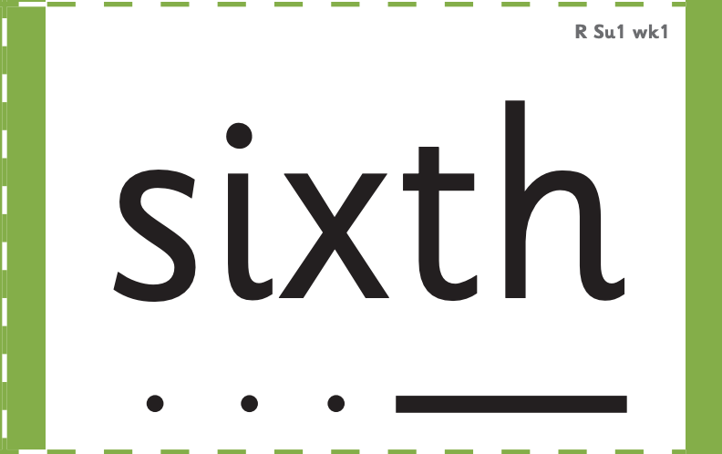

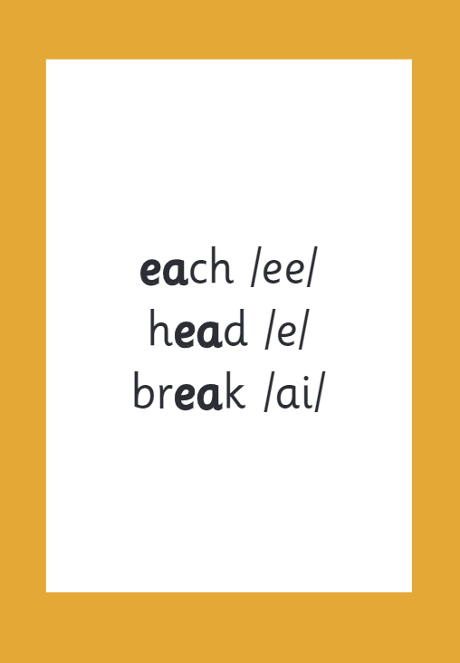

How we make learning stick
Notes:
There are specific resources for the Little Wandle Programme which the children will be very familiar with. Each sound that we teach to begin with has either a mnemonic (like the astronaut that you can see here) or a phrase like boing-boing for ‘oi’. This helps the children recognise and remember the graphemes. Every time we teach a new sound, we also read words during the phonics lesson that contain that new sound so that the children practise what they have learned. We then go on to reading a sentence containing some of those words. We have displays in the classroom and on the tables to support the children throughout the day.

Slide 13
Reading and spelling

Slide 14
Reading and spelling
This is an example of what the children learn in Year 1. Children learn that there are graphemes that can have different sounds and sounds that can be made with different letters
Notes:
This is an example of what the children learn in Year 1.
Children learn that there are graphemes that can have different sounds and sounds that can be made with different letters.
Use the backs and fronts of Phase 5 cards to show ‘ea’ and ‘ow’.

Slide 15
And all the different ways to write the phoneme sh:
shell
chef
special
caption
mansion
passion

Slide 16
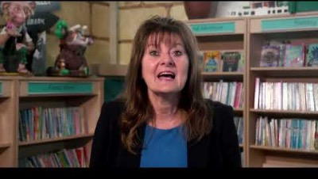
Tricky words
Notes:
Have a look at this video on the website: https://www.littlewandlelettersandsounds.org.uk/resources/for-parents/

Slide 17

Spelling
Say the word.
Segment the sounds.
Count the sounds.
Write them down.
Notes:
Model the process on a flipchart for the parents to see.

Slide 18
How do we teach reading in books?
Reading practise sessions are:
Timetabled 3 times a week
Taught by a teacher or teaching assistant
Taught in small groups
Reading practice books are carefully matched so children can read fluently and independently.
3 Reads – each one begins with quick sound and word practice
1. Decoding (sounding out the words)
2. Prosody (intonation, expression- making the book sound more interesting )
3. Comprehension
Please do not worry that a book is too easy – your child needs to develop fluency and confidence in reading. The more children see words the more they begin to read them automatically. Re-reading a book they have had before helps develop fluency – this is the goal.
Celebrate their success!
Notes:
The children read the same book three times in a week. The first time we work on decoding (sounding out) the words, the second time we work on prosody which is reading with expression – making the book sound more interesting with our story-teller voice – and the third time we look at comprehension. We read the books three times at school because we want to develop the fluency. The more they see words the more they begin to read them automatically without having to sound them out.

Slide 19
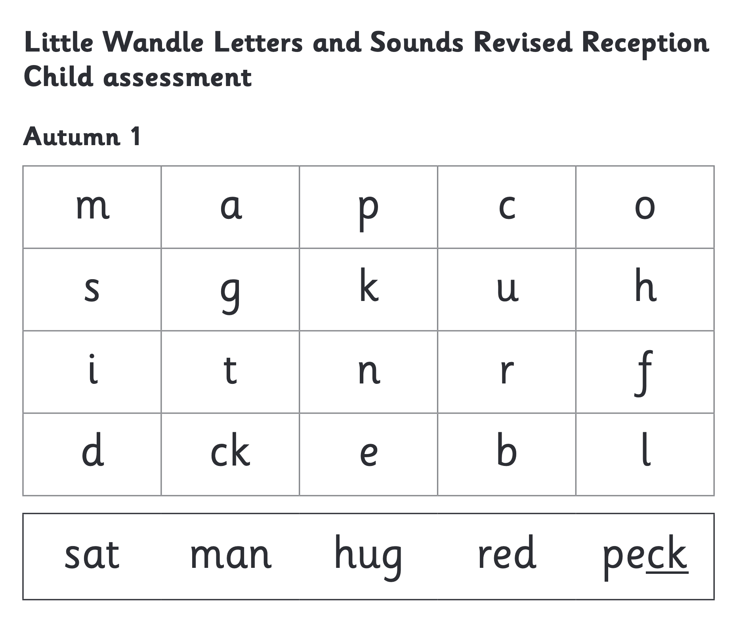
We use assessment to match your child the right level of book
Notes:
We assess your child every six weeks to check progress. Any child who needs extra support has daily keep-up sessions planned for them.

Slide 20
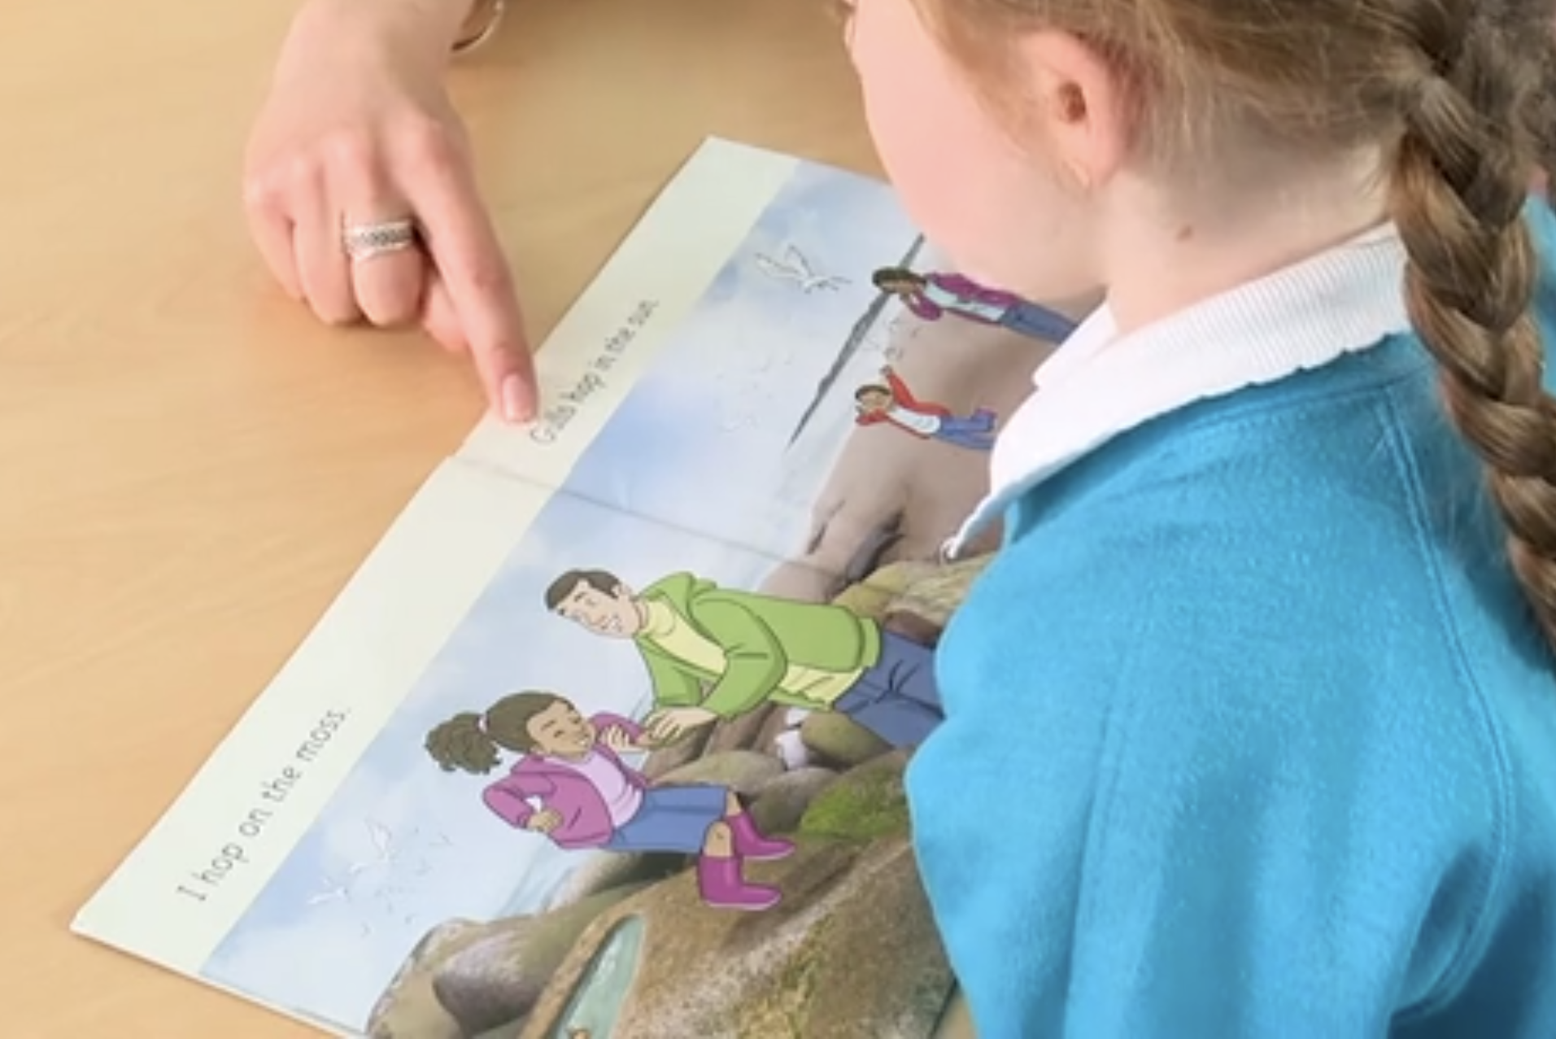
Reading a book at the right level
This means that your child should:
Know all the sounds and tricky words in their phonics book well
Read many of the words by silent blending (in their head) – their reading will be automatic
Only need to stop and sound out about 5% of the words– but they should be able to do this on their own.

Slide 21
Reading at home

Slide 22
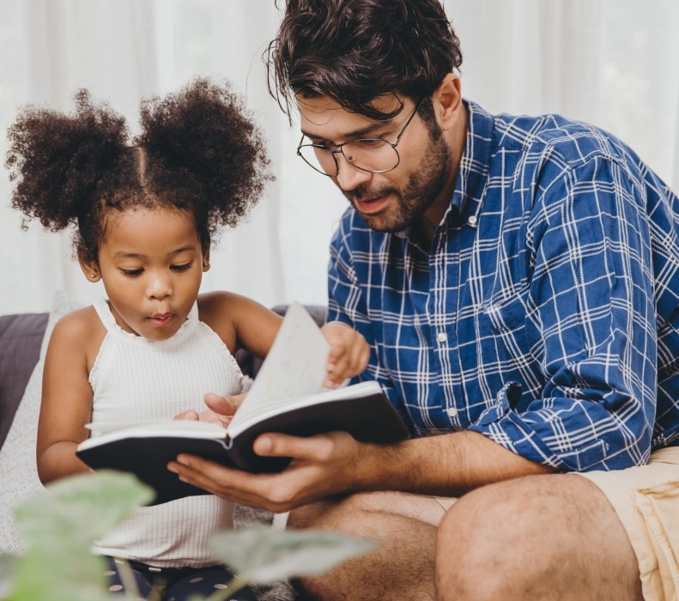
The most important thing you can do is read with your child
Reading a book and chatting had a positive impact a year later on children’s ability to…
understand words and sentences
use a wide range of vocabulary
develop listening comprehension skills.
The amount of books children were exposed to by age 6 was a positive predictor of their reading ability two years later.
Parental involvement in the development of children’s reading skills: A five-year longitudinal study (2002) Senechal, M. and Lefvre, J
Notes:
Celebrate child’s success at school, make time for reading at home!

Slide 23

Books going home
Notes:
As well as the ‘learning to read’ book that your child will bring home they will also bring home a book for sharing with you. This book is SO important. This is how we are going to give them the WILL to read. Please read with your child as often as you can – at least once a day if possible.

Slide 24
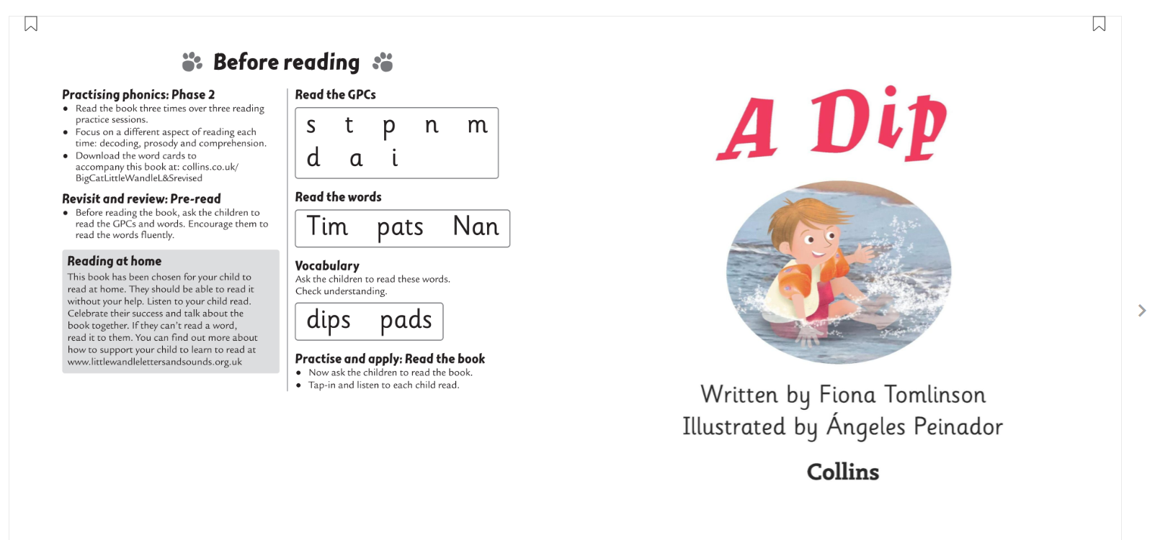
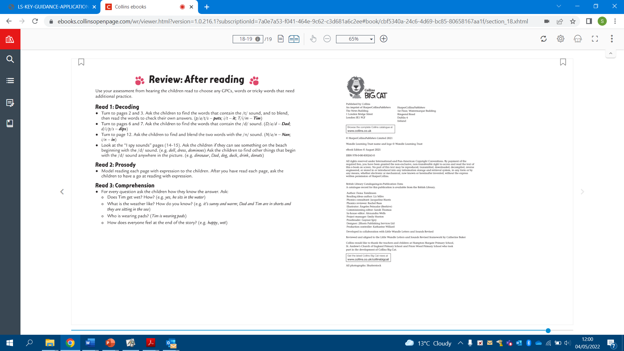
Listening to your child read their phonics book
Your child should be able to read their book without your help.
If they can’t read a word read it to them.
Talk about the book and celebrate their success.
Before reading
Each book has guidance about how you can support your child to read. It can be found at the front and back of the book.
After reading

Slide 25
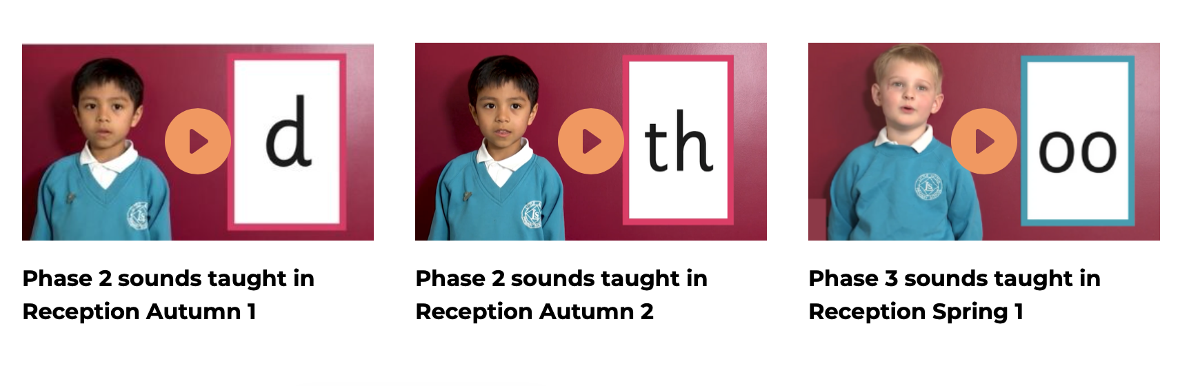
Supporting your child with phonics
Notes:
It is really important that you pronounce the sounds correctly at home if you are supporting your child. These videos are on the website for you to refer to and if you are unsure, please ask your child’s teacher.
Show the parents where to access the videos on the website and play them!
https://www.littlewandlelettersandsounds.org.uk/resources/for-parents/

Slide 26

Read to your child
The shared book is for YOU to read:
Make the story sound as exciting as you can by changing your voice.
Talk with your child as much as you can:
  Introduce new and exciting language
  Encourage your child to use new vocabulary
  Make up sentences together
  Find different words to use
  Describe things you see.

Slide 27
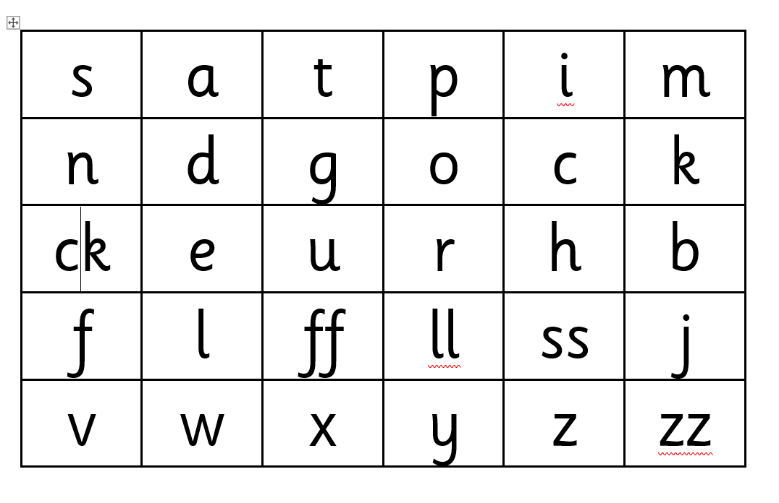
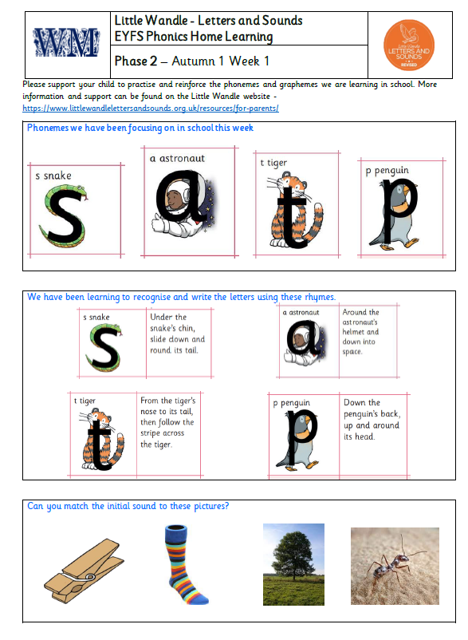
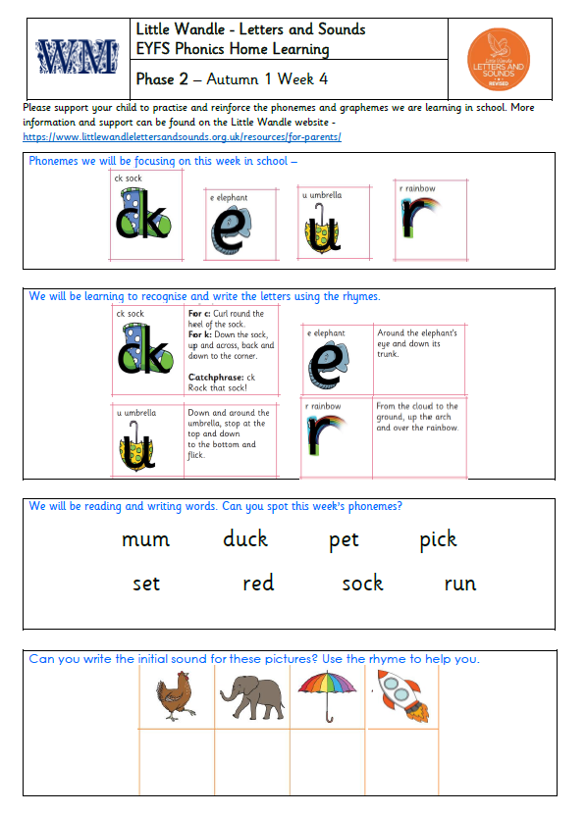
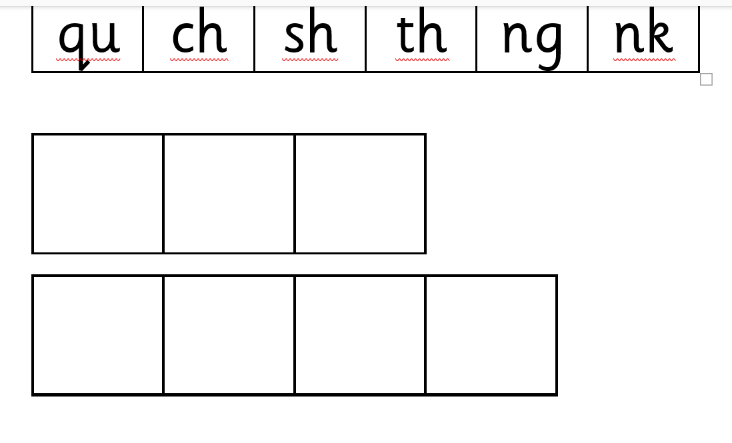
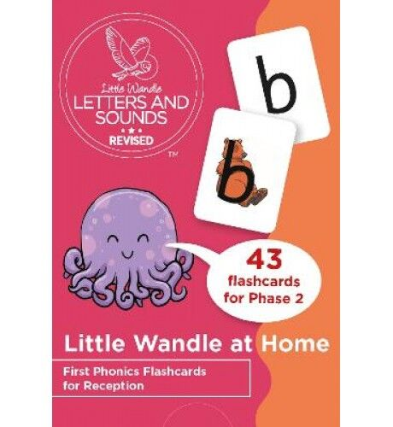
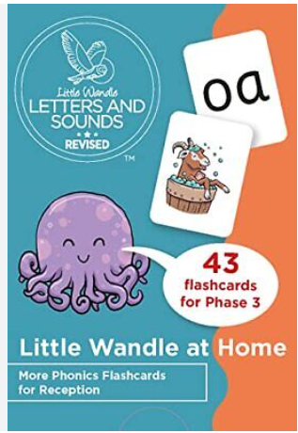
Phonics Home Learning

Slide 28
One of the greatest gifts adults can give is to read to children
Carl Sagan

